Slide 1
TEFAP Training For EFO’s August 2022

Slide 2
Meeting Agenda
TEFAP Background
EFO Responsibilities
Key Program Elements
Civil Rights
Basic Food Safety
Q&A

Slide 3
Where did it all start?
TEFAP stands for The Emergency Food Assistance Program
Founded in 1981 due to surpluses
TEFAP continues to purchase those surpluses from the food production market and distributes them to the states. The states then distribute the surpluses to food banks and food banks make it available to pantries.
Those pantries are referred to as EFOs or Emergency Feeding Organizations
The food banks are responsible for training and monitoring the EFOs
Virginia Department of Agriculture and Consumer Services (VDACS) is the state agency in Virginia that administers the TEFAP

Slide 4
Your responsibilities as an EFO
Sign & Comply with VDACS and BRAFB Agreements
Store & Distribute safely and in accordance with guidelines
Determine Eligibility; gather information for the Self Declaration of Income Forms or Link2Feed without requiring proof from the applicant
Conduct distributions at least monthly, with no limits on the amount of USDA product that clients can receive
Conduct monthly inventory of USDA product
Submit reports as required by food bank
Make corrective action to any instruction from BRAFB, VDACS, or USDA
Maintain copies

Slide 5
Key Program Elements

Slide 6
Household Eligibility
TEFAP eligibility based on Household income
Group of related or non-related individuals who are not residents of an institution but who are living as one economic unit sharing common cooking facilities and where food is purchased in common.
If individuals (related or non-related) reside together but prepare their meals separately, the deciding factor will be whether significant household expenses are shared
Link2Feed automates eligibility certification

Slide 7
Household Eligibility
Please make sure you qualify all households through the USDA qualifying screen first
During COVID-19, client signatures are waived. Pantry volunteers may sign for the client
Clients are re-certified every two years

Slide 8
Categorical Eligibility
Household Benefits:
TANF – Temporary Assistance for Needy Families
SNAP – Supplemental Nutrition Assistance Program
Individual Benefits:
SSI – Supplemental Security Income
Medicaid

Slide 9
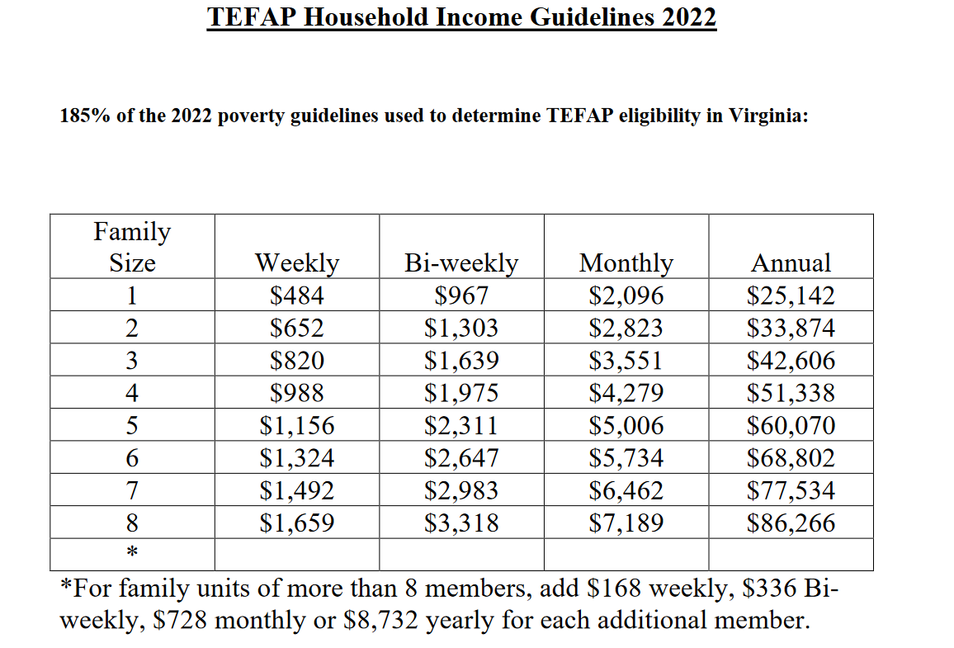
2021 TEFAP Household Income Guidelines

Slide 10
Income Eligibility
Gross Household Income Includes ALL income for EVERY member of the household:
Income to foster caregivers:
This income must be declared if foster children counted toward household size; does not have to be included if children not counted toward household size.
Wages Pensions Social Security SSI Railroad Retirement Income from property | Interest or dividends Strike benefits Unemployment compensation Alimony and child support Veteran’s benefits Insurance and annuity payments

Slide 11
Distribution Guidance
USDA food may be distributed to a household once per week.
An average sized household may receive any combination of available USDA canned and boxed food items. Currently there is no limit of how much USDA foods a family may receive.
All USDA foods must be maintained and distributed in the original packaging.

Slide 12
Destruction of USDA Foods
All damaged USDA foods such as unsalvageable and/or outdated foods not fit for human consumption must have all USDA identifiable labels removed. They must be rendered unusable and be disposed of by burying or incinerating at a local landfill. Damaged foods must be removed immediately unless required for later inspection by VDACS.
If you have damaged USDA product, please let BRAFB know so we can notify VDACS and get approval for destruction.
All damaged USDA foods shall be reported on monthly inventory report.

Slide 13
Demonstrations With USDA Food
TEFAP commodities can be used for educational demonstrations at the EFO. Records should be maintained and the next Inventory Report should include these as “distributed” foods.

Slide 14
Recordkeeping and Reporting
Required Reporting to BRAFB:
Monthly Inventory of USDA food, if you are taking inventory by case count please note this on inventory form
Link2Feed with TEFAP application
All records must be retained for three years plus the current year
Any SDOI forms on hand after the fiscal year must be returned to the Food Bank by July 5.

Slide 15
Civil Rights
Ensuring Access During Food Distribution

Slide 16
Primary Responsibility
Ensure that no person is excluded from participation in, denied benefits of, or is subject to any discrimination under TEFAP

Slide 17
Non-Discrimination Statement
All public announcements and documents must include non-discrimination statement.
Full statement, except where space does not permit, then:
“This institution is an equal opportunity provider.”

Slide 18
Required Displays At Distribution Sites
USDA civil rights poster “And Justice for All”
Civil Rights Complaint Information and Form
Multiple languages, where appropriate

Slide 19
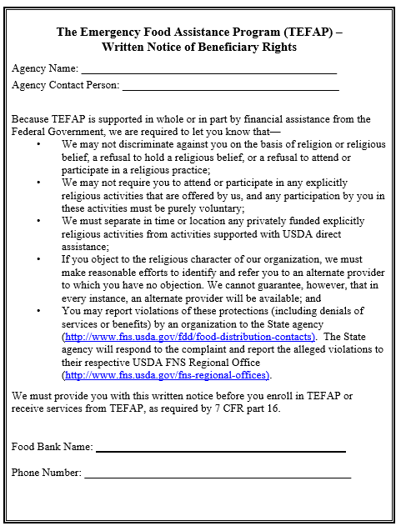
Required Displays- continued
7 CFR Part 16 – Notice of right to be referred to an alternative non-religious provider where available

Slide 20
Religious Activities
Agencies may not engage in inherently religious activities, such as worship, religious instruction, or proselytization, as part of the programs or services supported with direct USDA assistance.
If an organization conducts such activities, the activities must be:
offered separately, in TIME or LOCATION, from the food distribution, and
participation must be voluntary.

Slide 21
Civil Rights Training
EFO’s must train their staff and volunteers on civil rights and procedures to handle a complaint.
Staff that interacts with the program applicants or participants, and those persons, who supervise staff, must be provided civil rights training on an annual basis. Training must be documented and include:
Knowledge of protected classes
Effective public notification
Complaint procedures and conflict resolution
Customer service
Language assistance and accommodation of persons with disabilities
Compliance review techniques and noncompliance resolution

Slide 22
Handling Civil Rights Complaints
All complaints alleging discrimination on the basis of race, color, national origin, age, sex or handicap must be accepted by the EFO.
Complaints may be accepted verbally or in writing. EFOs should use the Civil Rights Complaint form to record pertinent information and should make all efforts to secure all of the information from the complainant.
No complaint shall be refused or ignored because the information is incomplete.
EFO should submit or facilitate submission of the form to VDACS

Slide 23
Food Safety
Ensuring Safe Food Distribution

Slide 24
Food Safety Review
Temperature Charts-3 times a week, more if possible
Refrigerators and Freezers must have internal thermometers
Refrigerators temp between 32-40 degrees
Freezer temp at or below 0 degrees
Shelf stable foods should be stored in a cool, dry location (between 40-70 degrees)
Keep items away from walls, steam pipes, chemicals and at least 6 inches off floor, away from walls and ceilings
Protect against pests and rodents
Remove refrigerated or frozen items immediately before providing to clients

Slide 25
Additional Storage Reminders
Adequate lighting
Adequate security
FIFO
No stock-piling-no more than you can distribute in 3 months
Clearly labeled as USDA

Slide 26
Questions?
Please contact your Partner Engagement Manager
Jacob Matz – jmatz@brafb.org - 540-450-3023
Clarke, Fauquier, Frederick, Loudoun, Page, Rappahannock, Shenandoah, Warren, & Winchester

