Slide 1
Link2Feed Report Examples

Slide 2
This presentation is a quick reference tool to help you narrow down the type of report to run for the data you need. The title in the upper left of each slide is the type of report and the screen shot is an example of the report displayed. Some reports have several slides.

Slide 3
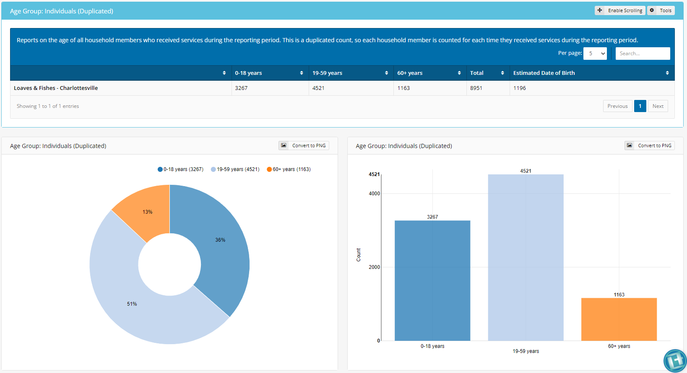
Agency Report
Name of organization

Slide 4
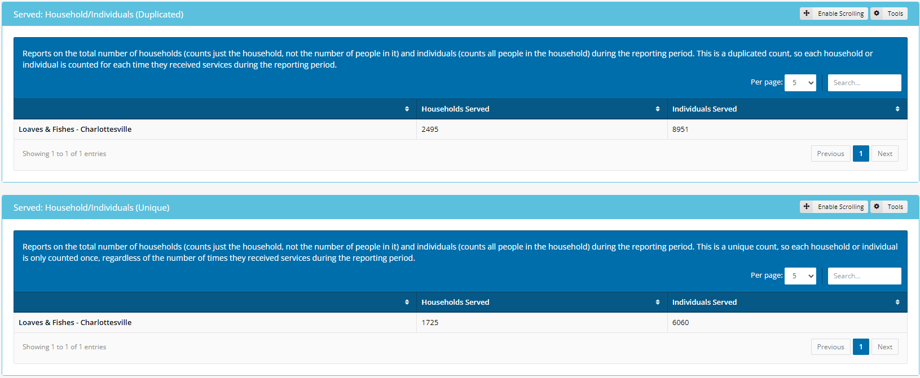
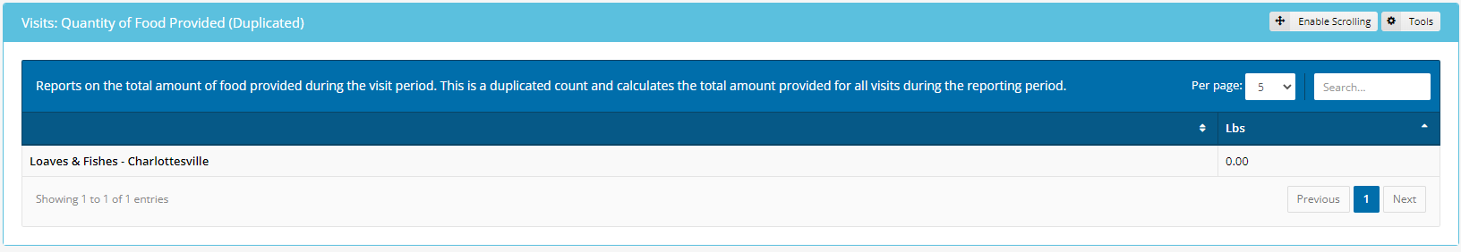
Agency Report
Name of organization
Name of organization
Name of organization
1235.00

Slide 5
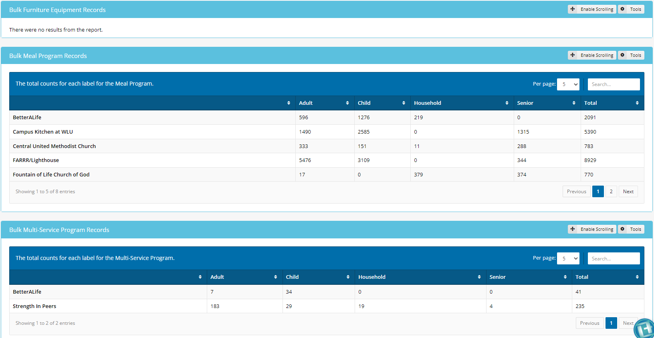
Bulk Report
Name of organization
Name of organization
Name of organization
Name of organization
Name of organization
Name of organization
Name of organization

Slide 6
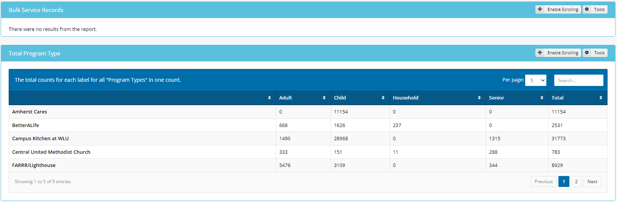
Bulk Report
Name of organization
Name of organization
Name of organization
Name of organization
Name of organization

Slide 7
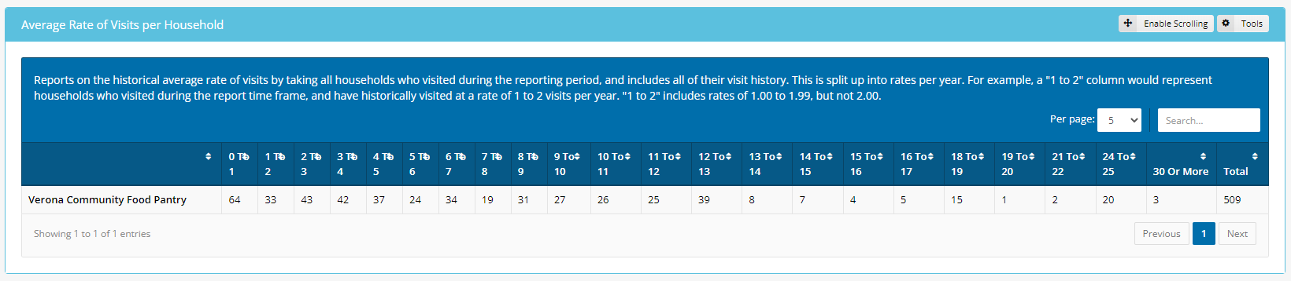
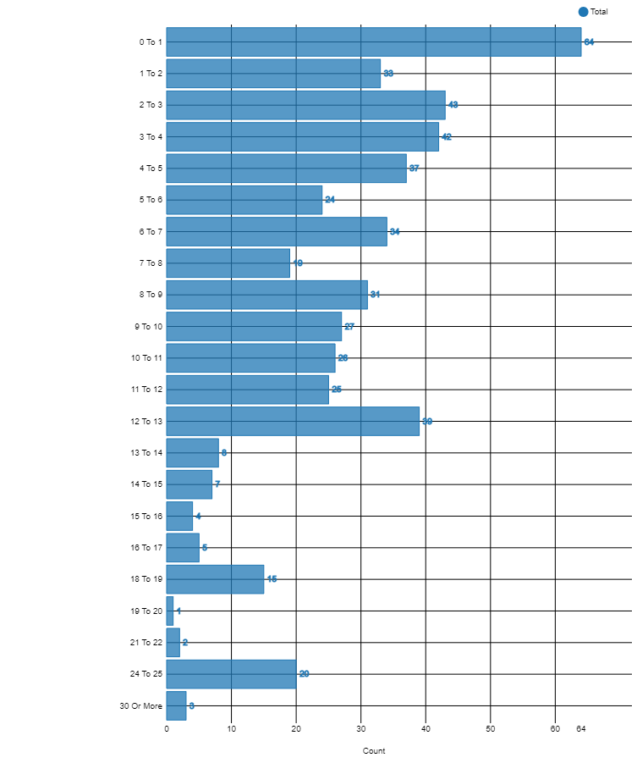
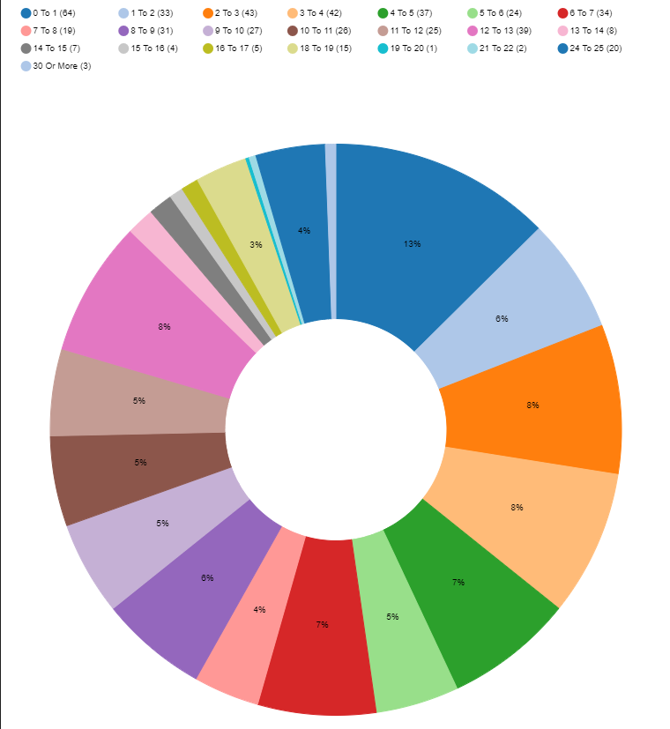
Client Status Report
Name of organization

Slide 8
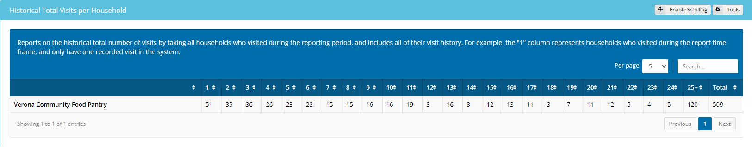
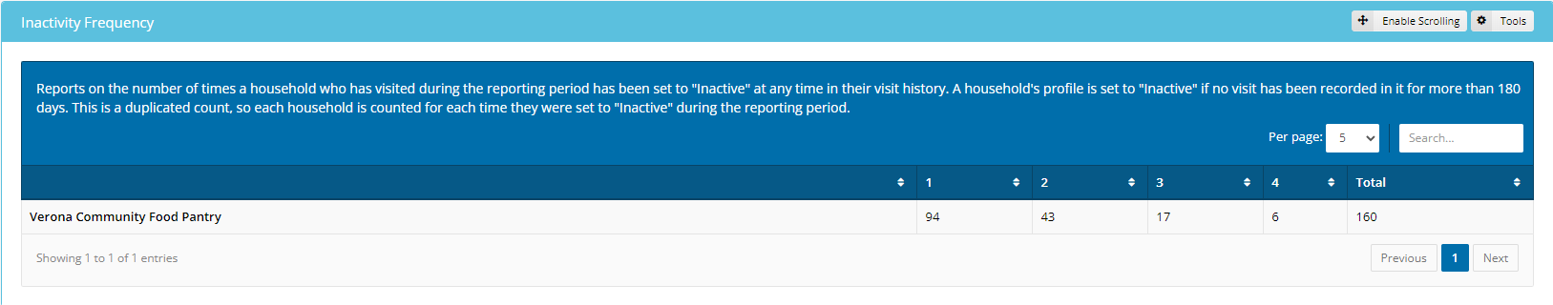
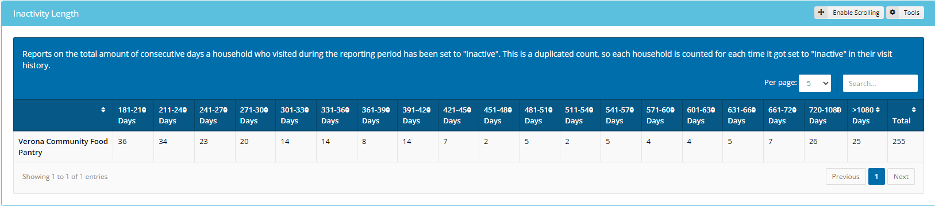
Client Status Report
Name of organization
Name of organization
Name of organization

Slide 9
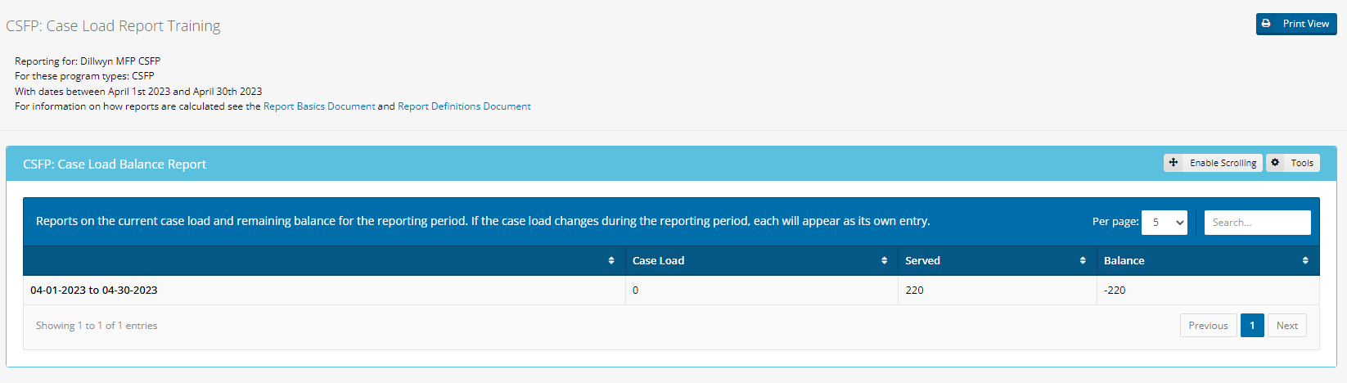
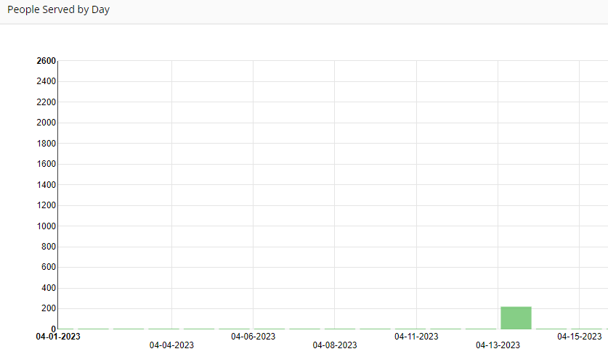
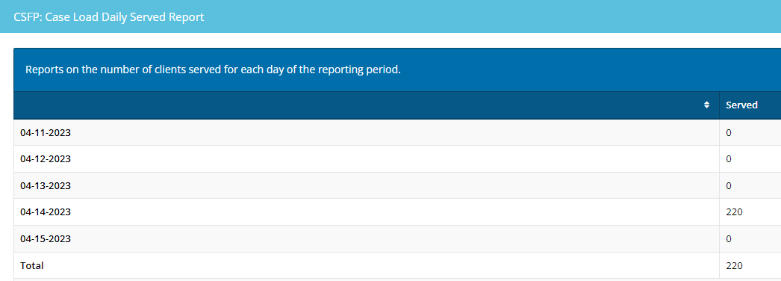
CSFP Case Load Report
Name of organization

Slide 10
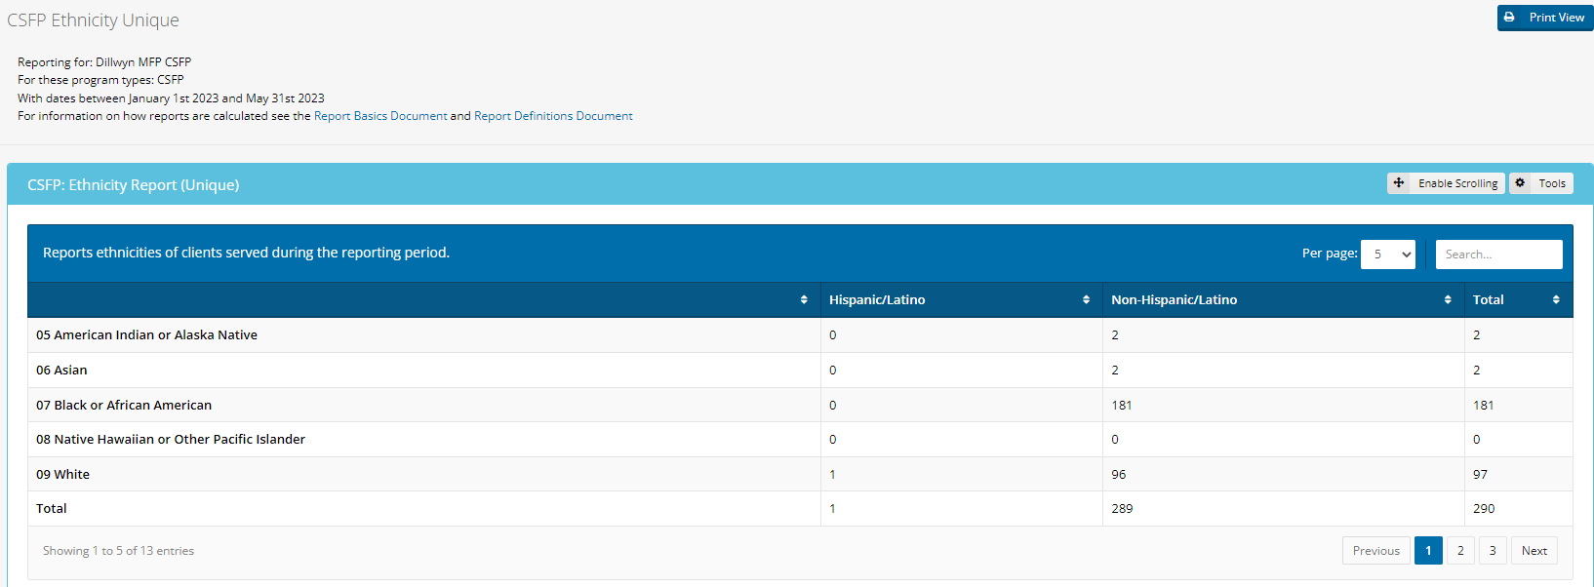
CSFP Ethnicity Report
Name of organization

Slide 11
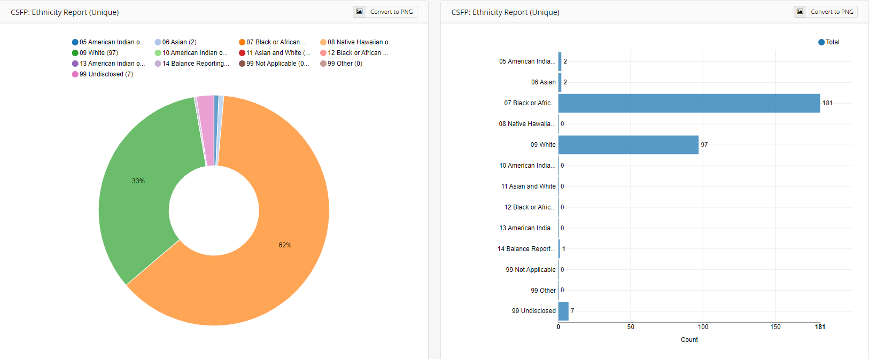
CSFP Ethnicity Report

Slide 12
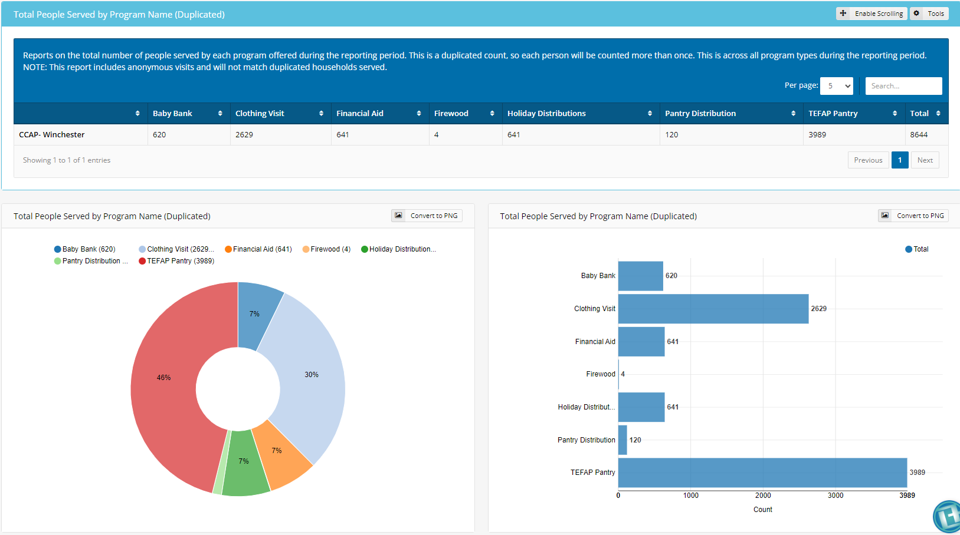
Generic Report
Name of organization

Slide 13
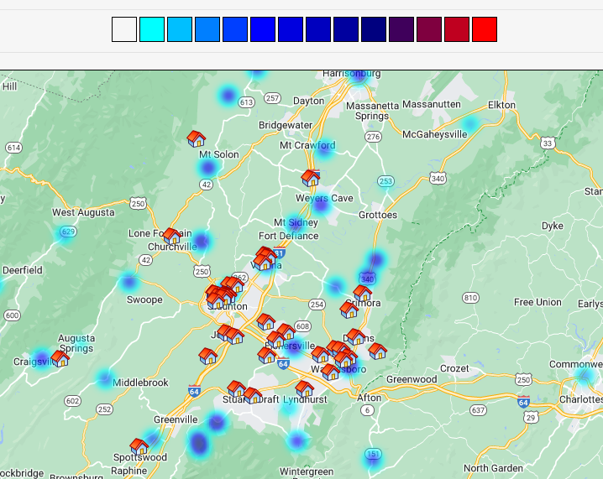


Heat Map Report – can be set to report on Age, Gender, Employment or services and the programs offered

Slide 14
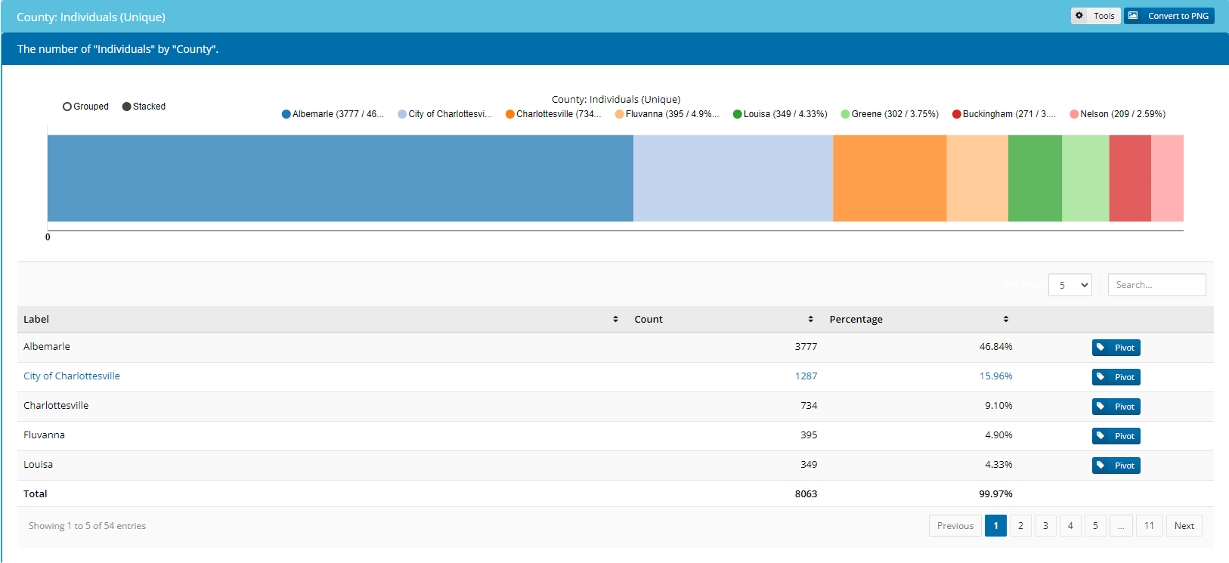
Interactive Household Report

Slide 15
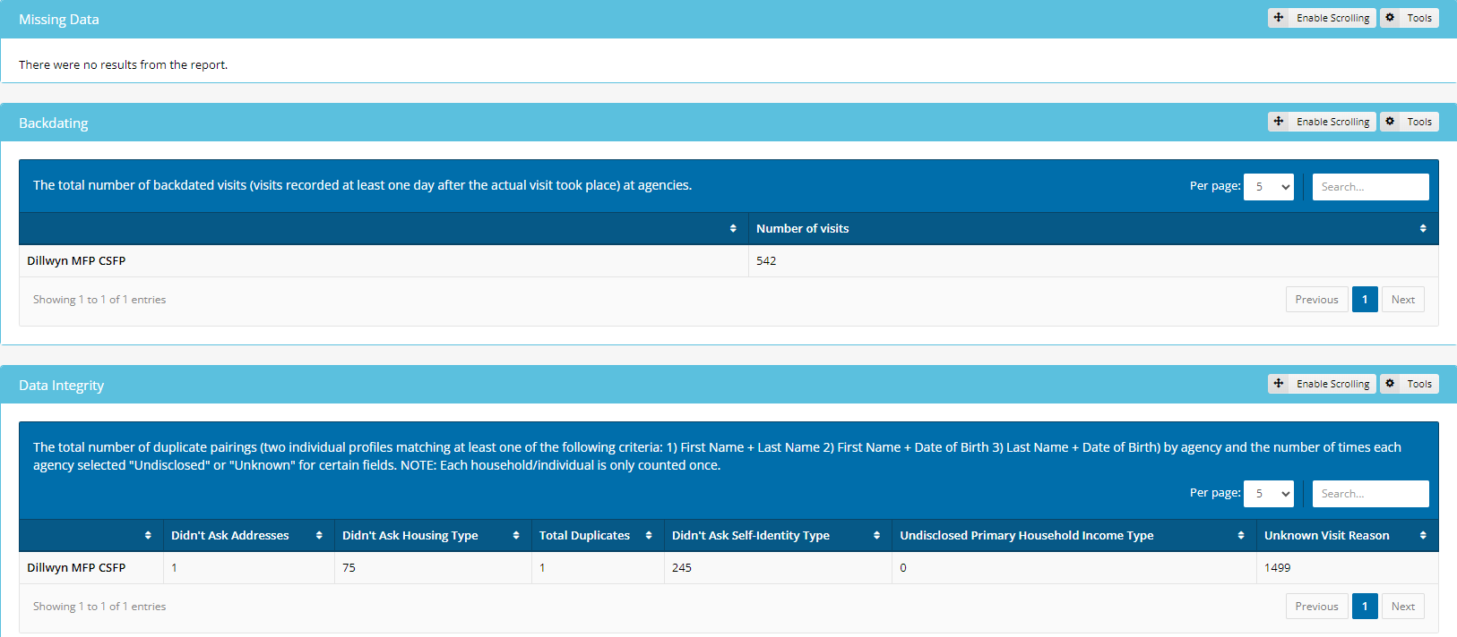
Monitoring Report
Name of organization
Name of organization

Slide 16
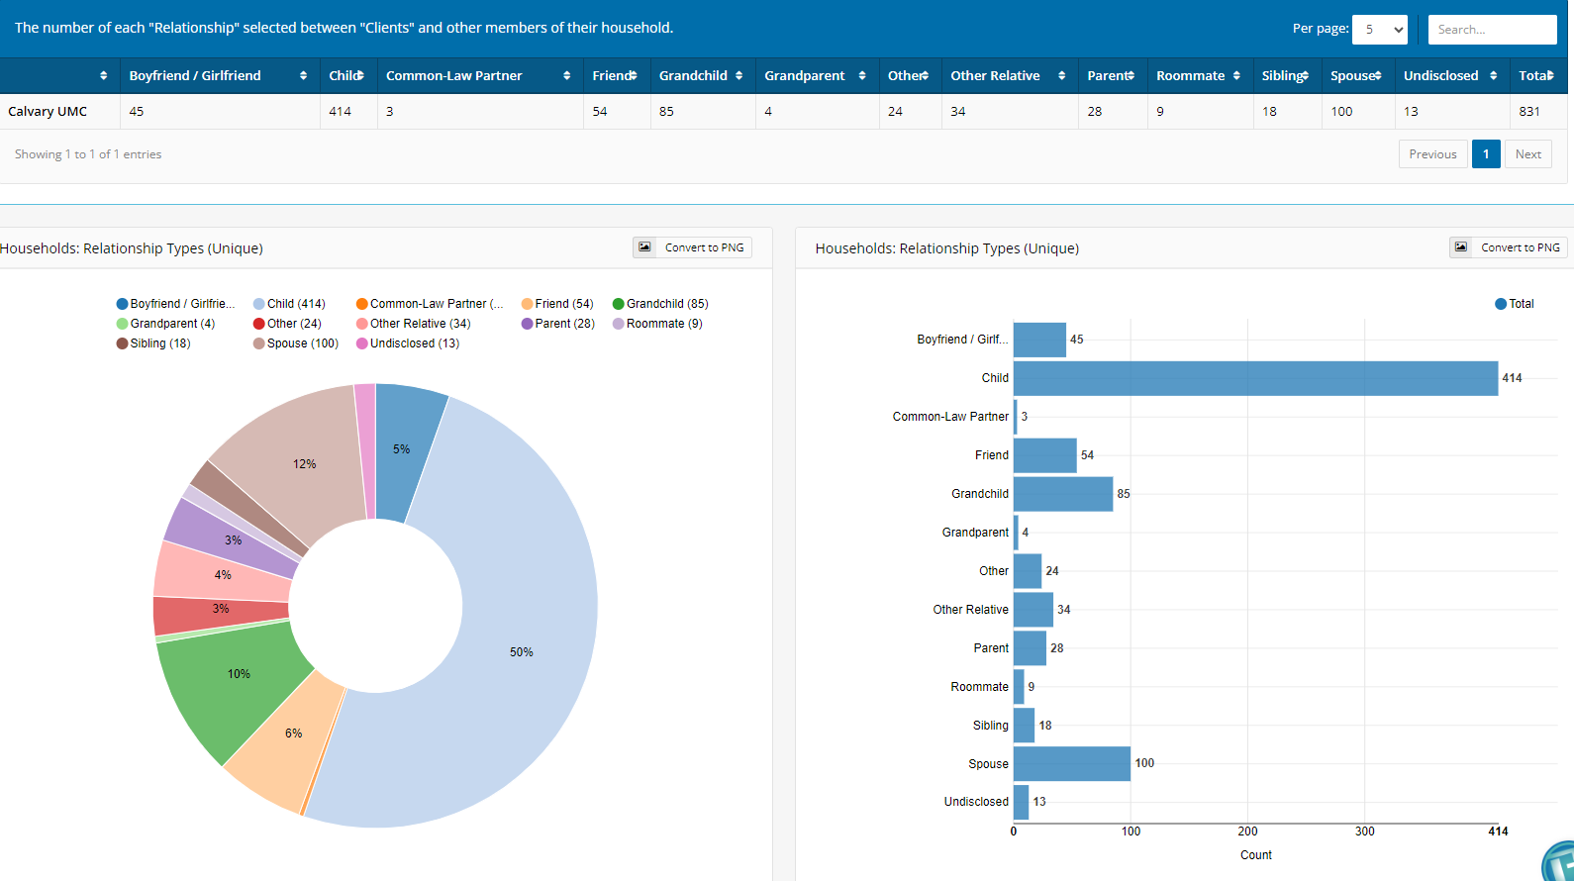
Statistics Report – can be run on Age, City, Country of Birth, County, Dietary Considerations, Disability, Education Country, Education Highest, Employment, Ethnicity, Expenses, Gender Identity, Household Social Programs, Households (this has the new verses existing), Housing Type, Immigration Period, Income (Net, all, highest, primary, monthly), Individuals (new vs. existing), Languages, Marital Status, Referred by, Self-Identifies As, Served, Visits (can break down by all data on visit screen), and Zip Code.
Name of organization

Slide 17
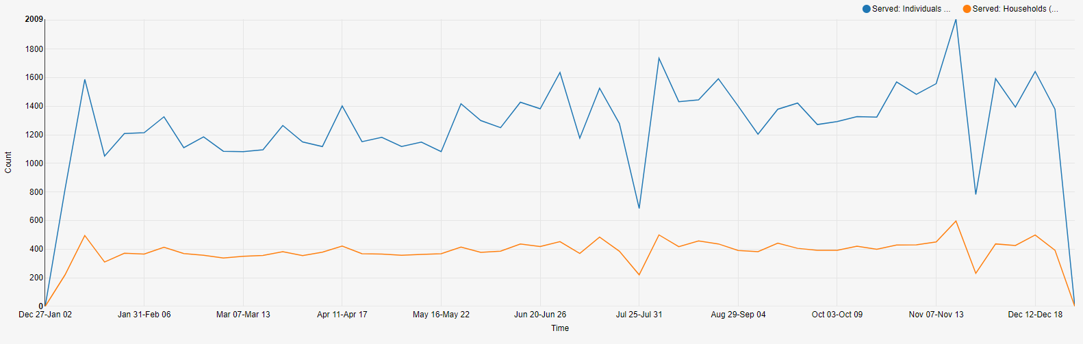
Time Series Report – can be run by day, week, month, and year on the following metrics: age groups, individuals or households served, quantity of food and new or existing individuals.

Slide 18
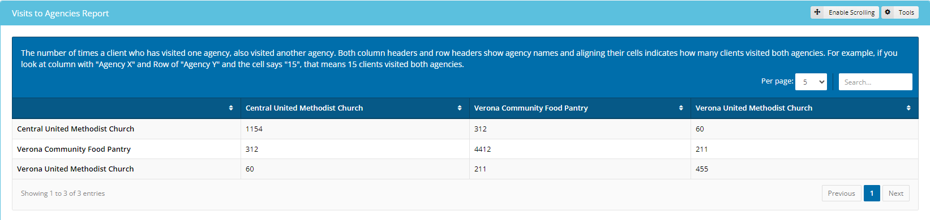
Visits to Agencies Report
Organization 1
Organization 2
Organization 3
Organization 1
Organization 2
Organization 3

