Slide 1

TEFAP Training For EFO’s
June 2024

Slide 2
Meeting Agenda
TEFAP Basic Information
Information for EFO’s
TEFAP Eligibility
Civil Rights
Food Safety
Q&A

Slide 3
TEFAP
Basic Information

Slide 4
TEFAP stands for The Emergency Food Assistance Program
Federal program that supplements diets of people experiencing food insecurity, including the elderly
Through TEFAP, USDA purchases high-quality foods, and makes those foods available to state distributing agencies
Virginia Department of Agriculture and Consumer Services (VDACS) is the state agency in Virginia that administers TEFAP
Amount of food received in VA is based on numbers of unemployed and people with incomes below poverty level

Slide 5
States provide food to agencies, like Food Banks, who in turn distribute the food to local organizations, such as food pantries, that directly serve the public
Those pantries are referred to as EFOs or Emergency Feeding Organizations
Food Banks are responsible for training and monitoring the EFOs

Slide 6
Responsibilities as an EFO
Read, sign, & comply with VDACS and BRAFB Agreements
Store & distribute food safely in accordance with guidelines
Determine Eligibility; gather information for Link2Feed or the Self Declaration of Income Forms without requiring proof from the applicant
Conduct distributions at least monthly
Conduct monthly inventory of USDA product and submit by the 5th of the following month
Submit reports as required by food bank
Make corrective action to any instructions from BRAFB, VDACS, or USDA
Maintain copies

Slide 7
Information for EFO’s
What You Need to Know

Slide 8
Damaged/Unsalvageable USDA Food
  If an EFO has damaged/unsalvageable USDA food, contact your PEM immediately. They will notify VDACS and get approval for destruction.
  DO NOT REMOVE/DESTROY/DISPOSE OF USDA food until told to do so!
  Document in writing what happened to the food and take pictures. Send documentation to your PEM.
  Once given approval to destroy, remove all labels, place in trash receptacle, take pictures of food in trash and send to PEM.
  All damaged USDA food needs to be reported on monthly USDA report.

Slide 9
Moving USDA Food
Prior to USDA food being moved to a new location (new pantry site, new storage facility, etc.), the EFO must notify the PEM.
The PEM will arrange for VDACS to conduct a monitoring visit at the new location for approval of the site.

Slide 10
Demonstrations With USDA Food
TEFAP commodities can be used for educational demonstrations at the EFO, but only with prior approval from VDACS. Records should be maintained and the next monthly USDA report should include these as “distributed” foods. Any use of USDA foods for unauthorized use will require restitution.

Slide 11
Distribution Guidance
  USDA food may be distributed to a household once per week.
  An average sized household may receive any combination of available USDA canned and boxed food items. Currently there is no limit of how much USDA foods a family may receive.
  All USDA foods must be maintained and distributed in the original packaging.

Slide 12
Recordkeeping and Reporting
Required Reporting to BRAFB:
  Monthly Inventory of USDA food, if you are taking inventory by case count, please note this on inventory form
  Link2Feed with TEFAP application
All records must be retained for three years plus the current year
Any SDOI forms on hand after the fiscal year must be returned to the Food Bank by July 5.

Slide 13
TEFAP Eligibility
How to Determine Eligibility

Slide 14
Household Eligibility
TEFAP eligibility is based on Household income or categorical eligibility.
Group of related or non-related individuals who are not residents of an institution but who are living as one economic unit sharing common cooking facilities and where food is purchased in common.
If individuals (related or non-related) reside together but prepare their meals separately, the deciding factor will be whether significant household expenses are shared
Link2Feed automates eligibility certification

Slide 15
Household Eligibility
Please make sure you qualify all households through the USDA qualifying screen first
VDACS has made signature waivers permanent. Instead of a name, type in “Covid Waiver”
(We anticipate in the near future that the requirement for “Covid Waiver” will be removed and no signature of any type will be required!)
Clients are re-certified every two years

Slide 16
Categorical Eligibility
Household Benefits:
TANF – Temporary Assistance for Needy Families
SNAP – Supplemental Nutrition Assistance Program
Individual Benefits:
SSI – Supplemental Security Income
Medicaid

Slide 17
Income Eligibility
Gross Household Income Includes ALL income for EVERY member of the household:
Income to foster caregivers:
This income must be declared if foster children counted toward household size; does not have to be included if children not counted toward household size.
Wages Pensions Social Security SSI Railroad Retirement Income from property | Interest or dividends Strike benefits Unemployment compensation Alimony and child support Veteran’s benefits Insurance and annuity payments

Slide 18
TEFAP Household Income Guidelines 2024*
250 % of the 2024 poverty guidelines used to determine TEFAP eligibility in Virginia
Family Size | Weekly | Bi-weekly | Monthly | Annual
1 | $725 | $1,569 | $3,138 | $37,650
2 | $983 | $2,130 | $4,259 | $51,100
3 | $1,242 | $2,690 | $5,380 | $64,550
4 | $1,500 | $3,250 | $6,500 | $78,000
5 | $1,759 | $3,811 | $7,621 | $91,450
6 | $2,018 | $4,371 | $8,742 | $104,900
7 | $2,276 | $4,932 | $9,863 | $118,350
8 | $2,535 | $5,492 | $10,984 | $131,800
*
* For family units of more than 8 members, add $259 weekly, $561 bi-weekly, $1,121 monthly, or $13,450 yearly for each family member.
Updated September 2024

Slide 19
Civil Rights

Slide 20
Primary Responsibility
Ensure that no person is excluded from participation in, denied benefits of, or is subject to any discrimination under TEFAP

Slide 21
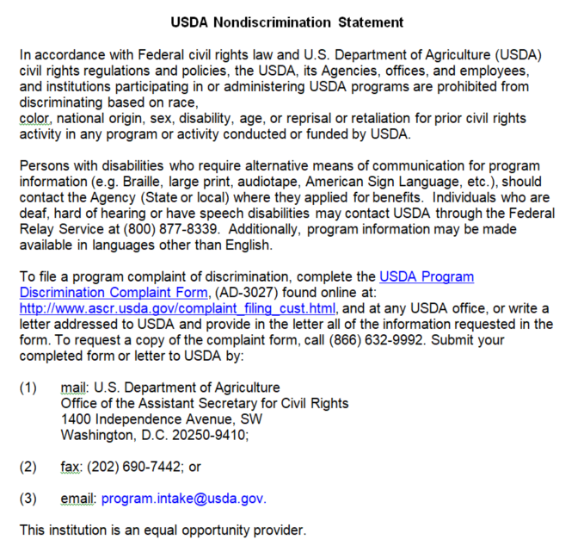
Non-Discrimination Statement
All websites, public announcements, flyers, and documents must include non-discrimination statement.
Full statement, except where space does not permit, then:
“This institution is an equal opportunity provider.”

Slide 22
Required Displays At Distribution Sites
(Must be displayed where guests can see and access the displays)
USDA civil rights poster “And Justice for All”
(now available in 60 different languages!)
Civil Rights Complaint Information and Form
Multiple languages, where appropriate

Slide 23
Religious Activities
Agencies may not engage in inherently religious activities, such as worship, religious instruction, or proselytization, as part of the programs or services supported with direct USDA assistance.
If an organization conducts such activities, the activities must be:
offered separately, in TIME or LOCATION, from the food distribution, and
participation must be voluntary.

Slide 24
Civil Rights Training
EFO’s must train their staff and volunteers on civil rights and procedures to handle a complaint.
Staff that interacts with the program applicants or participants, and those persons, who supervise staff, must be provided civil rights training on an annual basis. Training must be documented and include:
  Knowledge of protected classes
  Effective public notification
  Complaint procedures and conflict resolution
  Customer service
  Language assistance and accommodation of persons with disabilities
  Compliance review techniques and noncompliance resolution

Slide 25
Handling Civil Rights Complaints
All complaints alleging discrimination on the basis of religion, race, sex, disability, age, national origin, sexual orientation, gender identity, etc. must be accepted by the EFO.
Complaints may be accepted verbally or in writing. EFOs should use the Civil Rights Complaint form to record pertinent information and should make every effort to secure all elements of data on the complaint form to help explain or resolve the situation.
No complaint shall be refused or ignored because the information is incomplete.
EFO should submit or facilitate submission of the form to the address on the complaint form. EFO will also need to let PEM know.

Slide 26
Food Safety
Ensuring Safe Food Distribution

Slide 27
Food Safety Requirements
Temp Charts- take temps and log at least 3 times a week
Refrigerators & Freezers must have internal thermometers
Refrigerators temp between 32°-40° degrees
Freezer temp at or below 0° degrees
Shelf stable foods stored in a cool, dry location (between 50°-70° degrees) with a thermometer
Keep food away from walls, steam pipes, chemicals and at least 6 inches off floor, 4 inches from walls, and 2 feet from ceilings

Slide 28
Food Safety Requirements (cont’d)
Protect against pests and rodents. Records of these inspections must be maintained and shown at monitorings.
Remove refrigerated or frozen items immediately before providing to clients
Adequate lighting to aid in rotation and inventory checks
Adequate security to guard against theft or vandalism
FIFO (First in, First Out)

Slide 29
Additional Food Safety Requirements
No stock-piling more than can distributed in 3 months
Clearly labeled as USDA and kept separate from non-USDA food
USDA food must be dated when received
Walnuts from USDA must be refrigerated!

Slide 30
Questions?
Please contact your Partner Engagement Manager
  Western Region - Robin Swecker - rswecker@brafb.org – 540-213-8413
  Augusta, Bath, Highland, Rockbridge & Rockingham
  Northern Region - Jacob Matz – jmatz@brafb.org - 540-450-3023
  Clarke, Fauquier, Frederick, Loudoun, Page, Rappahannock, Shenandoah, Warren, & Winchester
  Eastern Region – Hanna Strauss – hstrauss@brafb.org – 434-220-5428
  Albemarle, Buckingham, Culpeper, Fluvanna, Greene, Madison & Orange
  Southern Region – Kristi West – kwest@brafb.org - 434-835-4129
  Amherst, Appomattox, Bedford, Campbell & Nelson

