Slide 1

[Insert # of Organizations in (Insert State)]​
Insert Org Logo​​

Slide 2

[Insert # of Organizations in (Insert State)]
Insert Org Logo​​

Slide 3

[Insert State]​
Insert Org Logo​

Slide 4
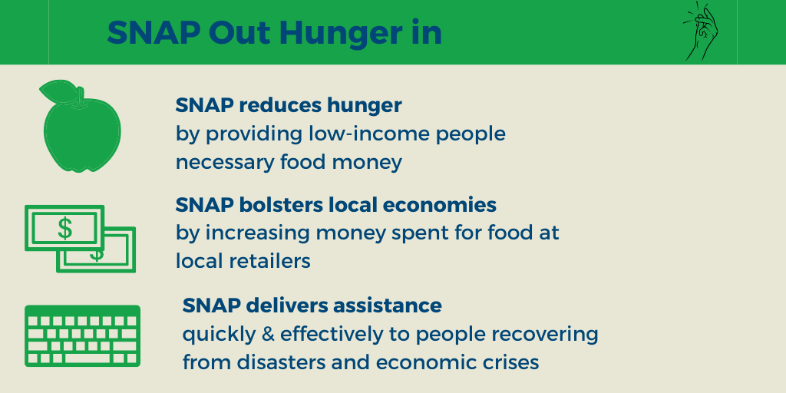
[Insert State]
Insert Org Logo

